Slide 1
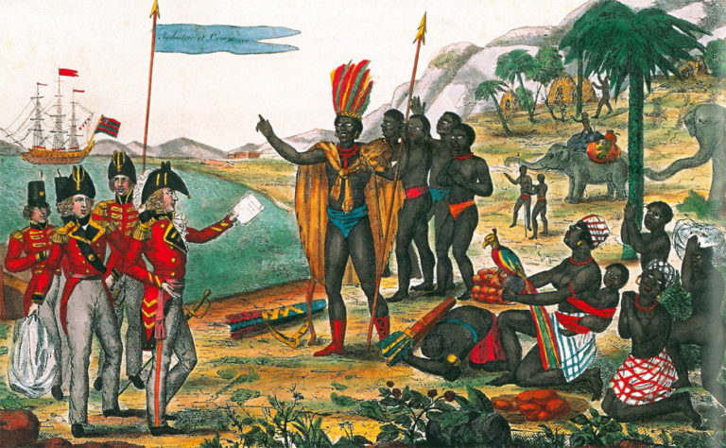
Analysis of selected passages in
Oroonoko killing his wife (P218-P228)
Reporter：*** ***

Slide 2
Analysis of selected passages in
Oroonoko killing his wife (P218-P228)
What do we read?
What can we relate to?
Eye-catching parts
The novel's unique writing technique

Slide 3
What do we read?

Slide 4
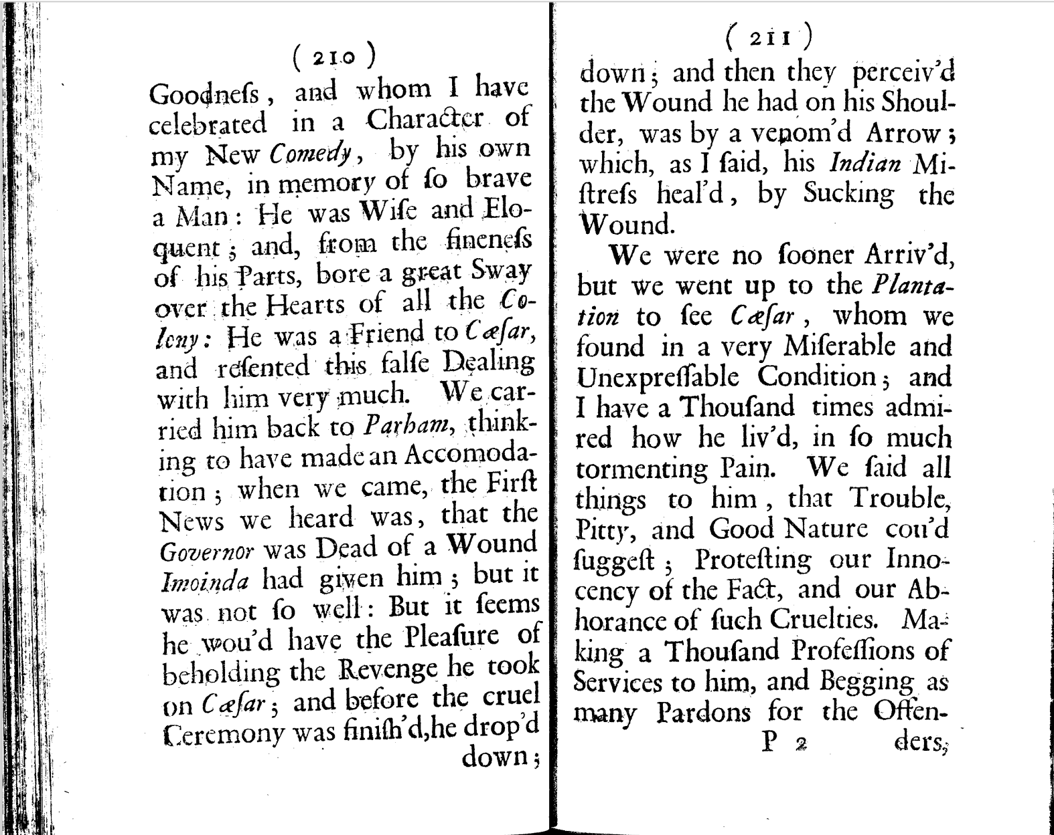
What do we read?
What do we read?

Slide 5
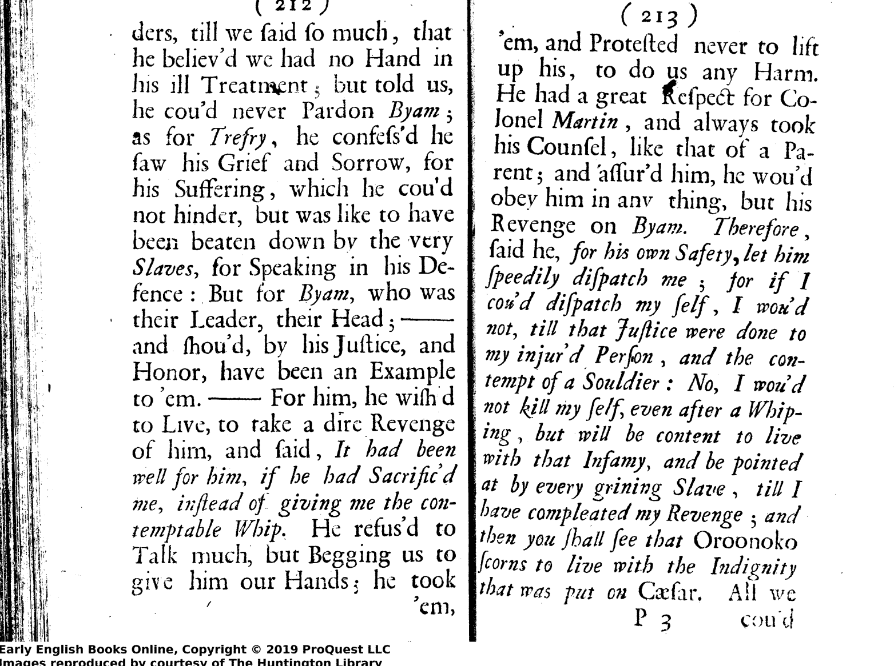
What do we read?

Slide 6
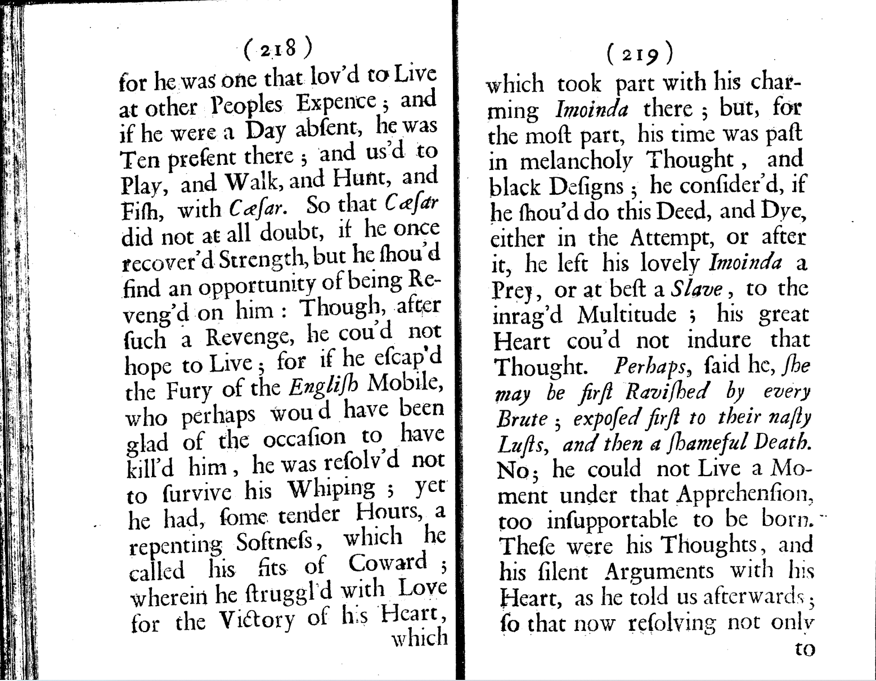
What do we read?

Slide 7
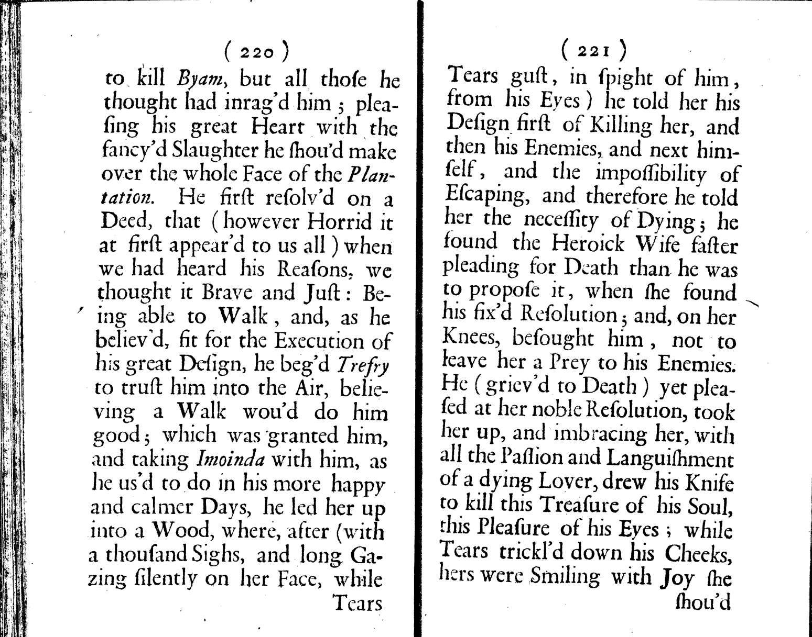
What do we read?

Slide 8
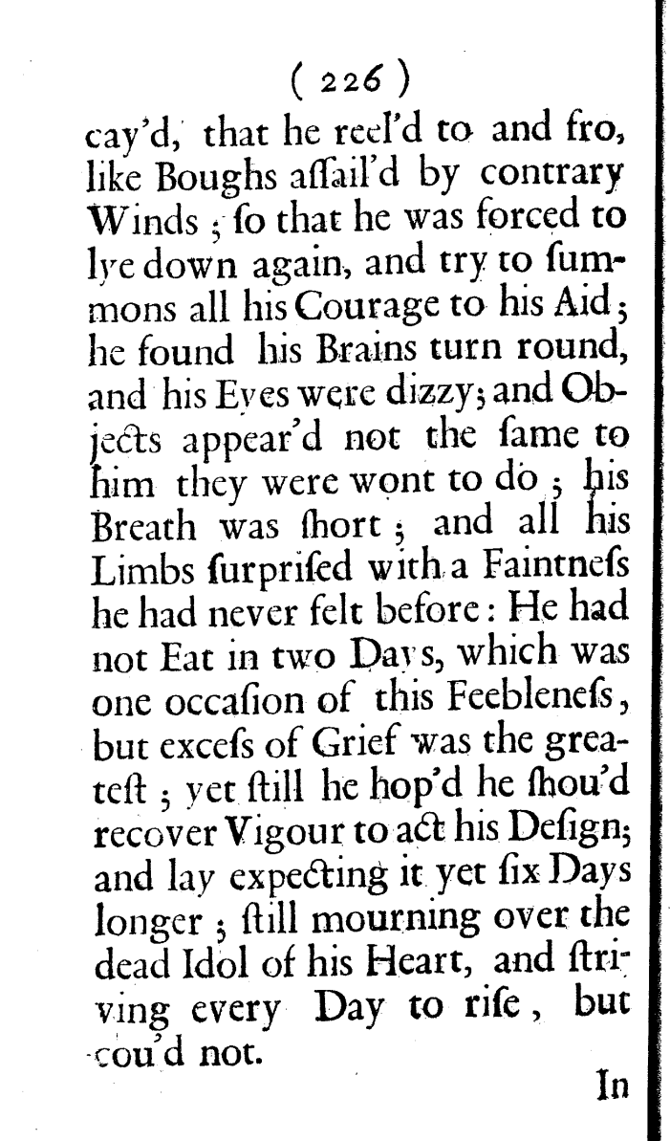
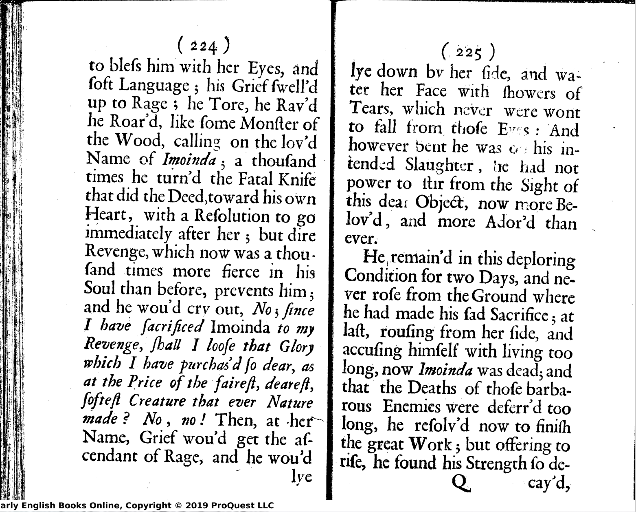


What do we read?
What do we read?

Slide 9
Analysis of selected passages in
Oroonoko killing his wife (P218-P228)
What do we read?
What can we relate to?
What can we relate to?
Eye-catching parts
The novel's unique writing technique

Slide 10
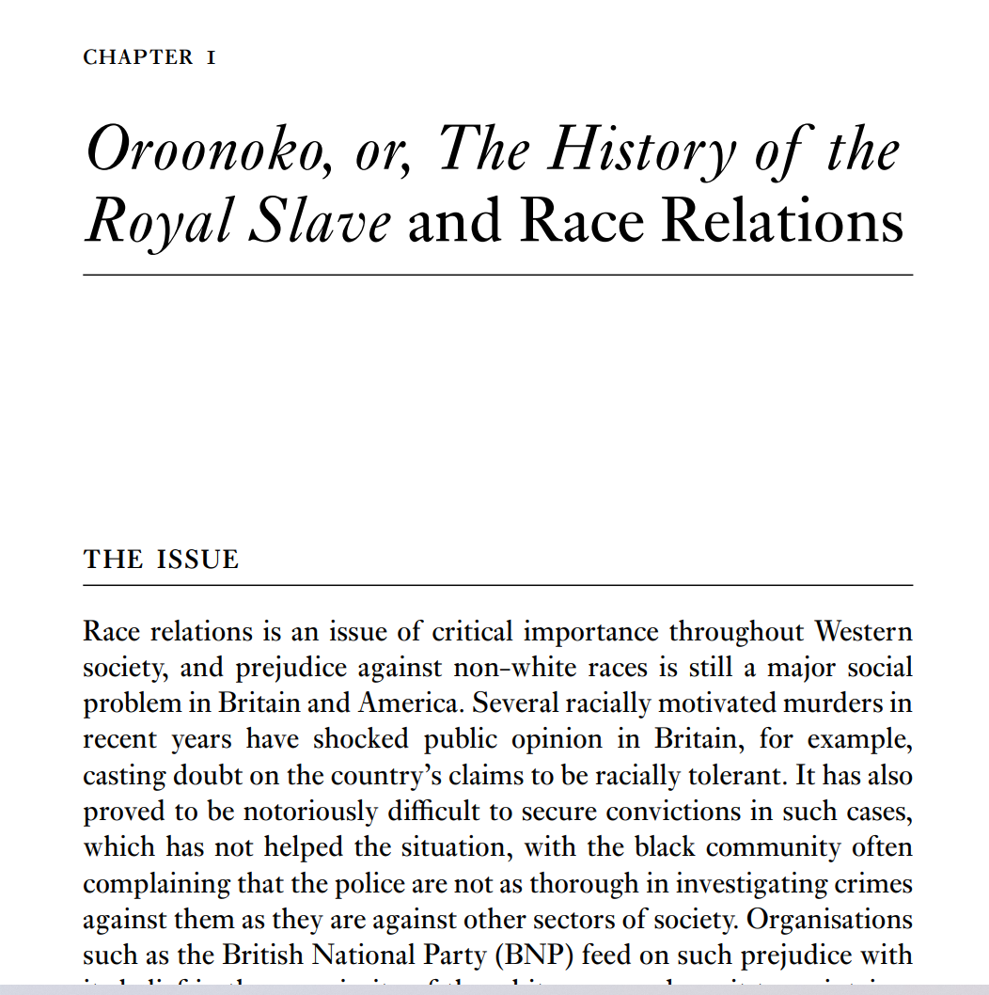
What can we relate to?

Slide 11
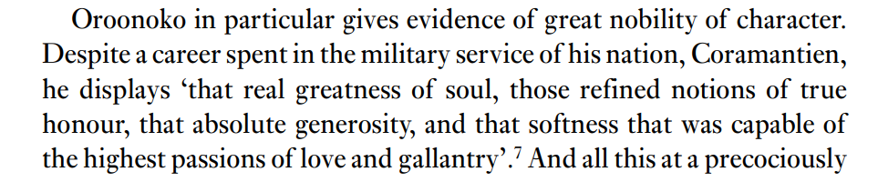
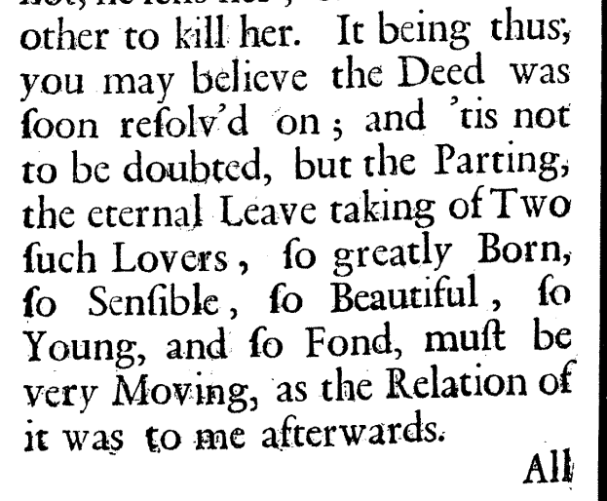

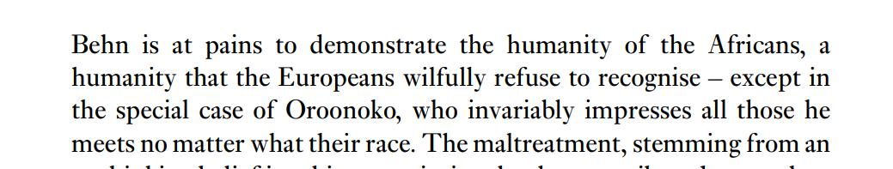
What can we relate to?

Slide 12
Analysis of selected passages in
Oroonoko killing his wife (P218-P228)
What do we read?
What can we relate to?
Eye-catching parts
The novel's unique writing technique

Slide 13
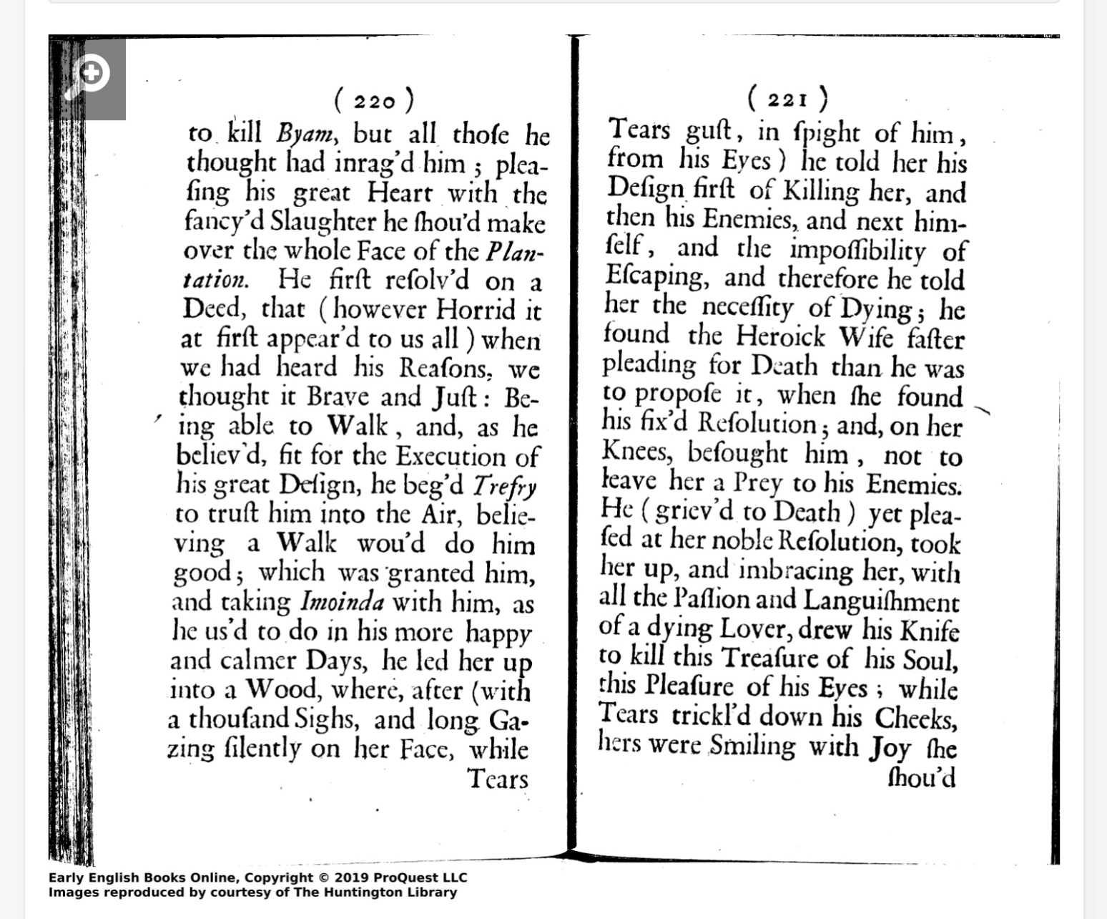
Eye-catching parts:

Slide 14
Eye-catching parts:
Linguistic description:
An exaggerated depiction of Oroonoko , showing the desperation he felt before he killed his wife

Slide 15
Eye-catching parts:
Linguistic description
exaggeration
Linguistic description:
An exaggerated depiction of Oroonoko , Showing the desperation he felt before he killed his wife

Slide 16
Eye-catching parts:
Linguistic description
exaggeration
Expressions description
Using “Silently” to modify gaze ,to perform his tenderness and deep love

Slide 17
Eye-catching parts:
Linguistic description
Expressions description
exaggeration
Expressions description
Using “Silently” to modify gaze ,to perform his tenderness and deep love

Slide 18
Eye-catching parts:
Linguistic description
Expressions description
exaggeration
Psychological description
With the help of external forms to express the intense inner grief

Slide 19
Eye-catching parts:
Linguistic description
Expressions description
Psychological description
Exaggeration
Psychological description
With the help of external forms to express the intense inner grief

Slide 20
Eye-catching parts:
Linguistic description
Expressions description
Psychological description
Exaggeration
Action description
It shows Omoinda's bravery and firmness as a woman
Oroonoko was touched by his wife's act of devotion

Slide 21
Eye-catching parts:
Linguistic description
Expressions description
Psychological description
Action description
Exaggeration
Action description
It shows Omoinda's bravery and firmness as a woman
Oroonoko was touched by his wife's act of devotion

Slide 22
Analysis of selected passages in
Oroonoko killing his wife (P218-P228)
What do we read?
What can we relate to?
Eye-catching parts:
Linguistic description
Expressions description
Psychological description
Action description
Exaggeration
The novel's unique writing technique

Slide 23
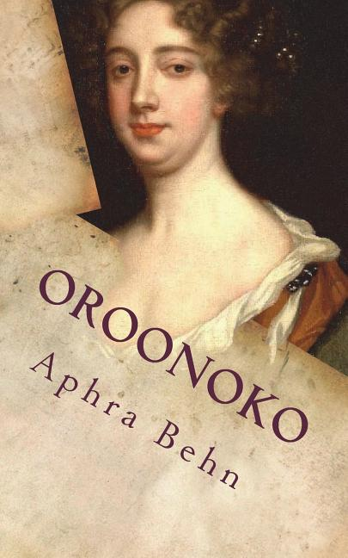
The novel's unique writing technique
A question:
By what we have summarized before
What makes the reader feel as if he were on the spot, following the hero's emotional ups and downs.
as if the joys and sorrows were happening to him?

Slide 24

The novel's unique writing technique
The answer is that the author describes details in many aspects ，from the point of view of an observer on the spot
Impressive characters
empathy
details

Slide 25
Analysis of selected passages in
Oroonoko killing his wife (P218-P228)
The novel's unique writing technique
What do we read?
What can we relate to?
Eye-catching parts
The novel's unique writing technique
The novel's unique writing technique

Slide 26
Thank you for your attention！

